Slide 1

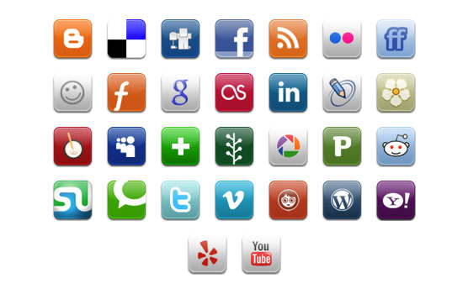
Content Curation Basics
By Helen Yingsheng Li
July, 2012

Slide 2
Content
 |  | Concept of Content Curation
 |  | Models of Content Curation
 |  | Value of Content Curation
A
B
C

Slide 3
There are 3 types of content (online).
Concept of Content Curation
A
B
C
Curation
Aggregation
Online Content
Creation

Slide 4
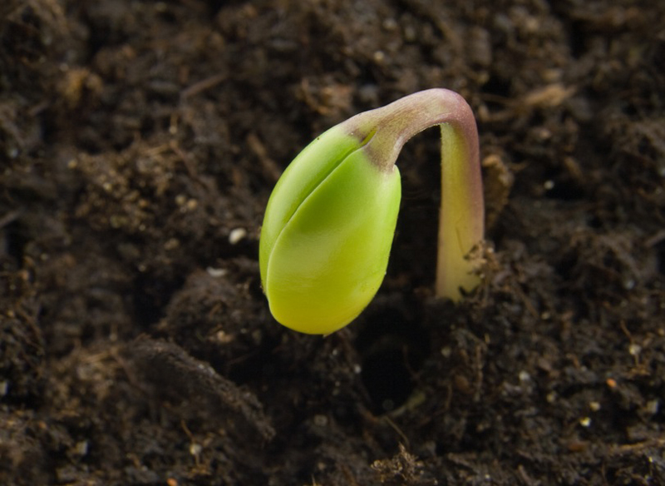
Creation is like planting seeds from scratch.
Concept of Content Curation
A
B
C
Metaphor on seeds was inspired by Corinne Weisgerber - Building Thought Leadership through Content Curation

Slide 5

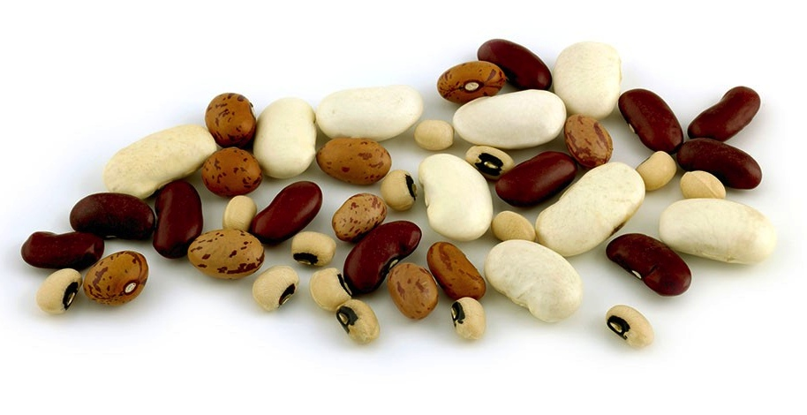
Aggregation is like simply gathering seeds together, which machine (or birds) can do.
Concept of Content Curation
A
B
C

Slide 6
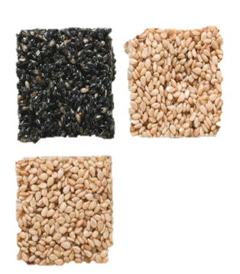
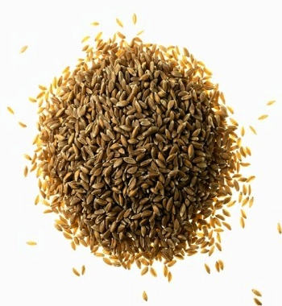

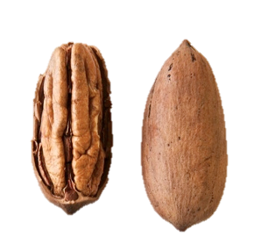
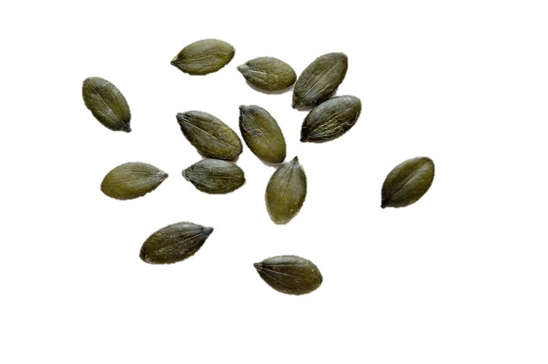
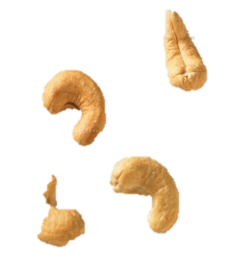

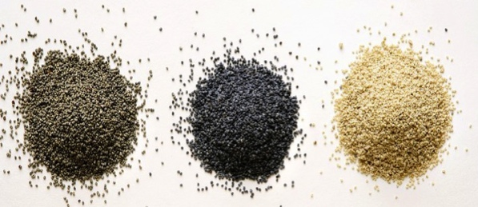
Curation is like sorting seeds out, putting them into contexts, framing them, so that they make sense
Concept of Content Curation
A
B
C

Slide 7

Concept of Content Curation
A
B
C
“
Content Curation is a term that describes the act of finding, grouping, organizing or sharing the best and most relevant content on a specific issue.
”
Rohit Bhargava
SVP, Global Strategy & Planning| Ogilvy
Author, Likeonomics, Personality Not Included
Professor, Global Marketing | Georgetown University

Slide 8
Curation goes through a 3-S process: Seeking, Sensing, Sharing. It’s a process of adding value to the audience.
Model of Content Curation
A
B
C
Seeking
Sensing
Sharing
Information from various sources
Curated content out through different social channels
Aggregation
Distillation
Elevation
Mashup
Chronology
Source: 3-S model from Beth Kanter; Sensing model from Rohit Bhargava

Slide 9
Model of Content Curation
A
B
C
Seeking
Define objectives and audience
Organize sources:
Use discovery tools
Scan more than you capture
Tools
Google Alerts
RSS
Twitter, Scoop.it, YouTube….etc.
Source: 3-S model from Beth Kanter; Sensing model from Rohit Bhargava

Slide 10
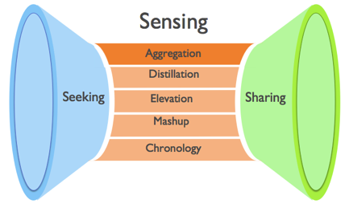
Model of Content Curation
A
B
C
Sensing - Aggregation
Aggregation is the act of curating the most relevant information about a particular topic into a single location
It is the most common form of content curation.
Examples
Link2Asia Week of July 13
Golden Bridges: China NPO Weibo Digest (October)
Notes:
1. Sensing is where value-adding takes place in curation.
2. The 5 models can be used alone or together.
Source: 3-S model from Beth Kanter; Sensing model from Rohit Bhargava

Slide 11
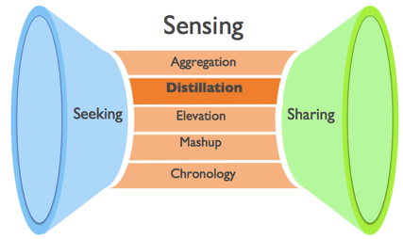
Model of Content Curation
A
B
C
Sensing - Distillation
Distillation is the act of curating information into a more simplistic format where only the most important or relevant ideas are shared.
Methods: summarizing, introduction
Examples
Academic Research Digest, October 2011
The Media Discusses Social Organization Management
Source: 3-S model from Beth Kanter; Sensing model from Rohit Bhargava

Slide 12
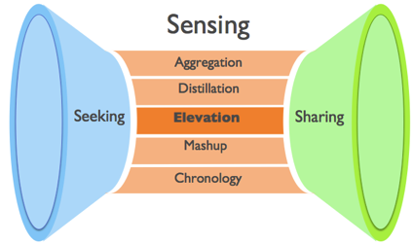
Model of Content Curation
A
B
C
Sensing - Elevation
Elevation refers to curation with a mission of identifying a larger trend or insight from smaller daily musings posted online.
one of the hardest forms of content curation requiring more expertise and analytical ability
Examples
Philanthropy Advising Series: Influences from the West
Chinese Philanthropy Beyond Rapidly Declining Number
Source: 3-S model from Beth Kanter; Sensing model from Rohit Bhargava

Slide 13
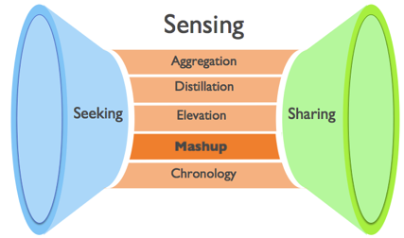
Model of Content Curation
A
B
C
Sensing - Mashups
Mashups are unique curated justapositions where merging existing content is used to create a new point of view.
Examples
Converting ideas in an article into a PowerPoint presentation is an example of Mashups, IMO.
Source: 3-S model from Beth Kanter; Sensing model from Rohit Bhargava

Slide 14
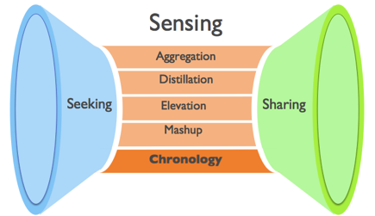
Model of Content Curation
A
B
C
Sensing - Chronology
Chronology is a form of curation that brings together historical information organized based on time to show an evolving understanding of a particular topic.
Examples
Memolane
SOPA Timeline
Source: 3-S model from Beth Kanter; Sensing model from Rohit Bhargava

Slide 15
Model of Content Curation
A
B
C
Sharing
Feed your network with a steady diet of good stuff
Comment on other people’s stuff
Collaborative sensemaking
Tools
Blogging
Twitter, Scoop.it, Pinterest, Storify etc.
Source: 3-S model from Beth Kanter; Sensing model from Rohit Bhargava

Slide 16
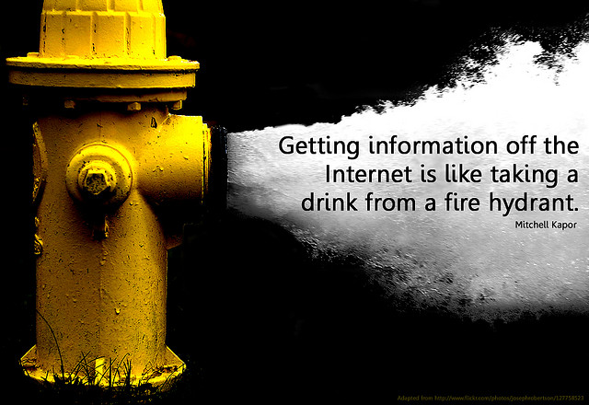
Value of Content Curation
A
B
C
Photo credit: Will Lion from Flickr

Slide 17

Value of Content Curation
A
B
C
Information overload is overwhelming!

Slide 18

Curation reduces information overload by providing filtered information.
Value of Content Curation
A
B
C
Hence come the values of content curation.
Value No.1:

Slide 19
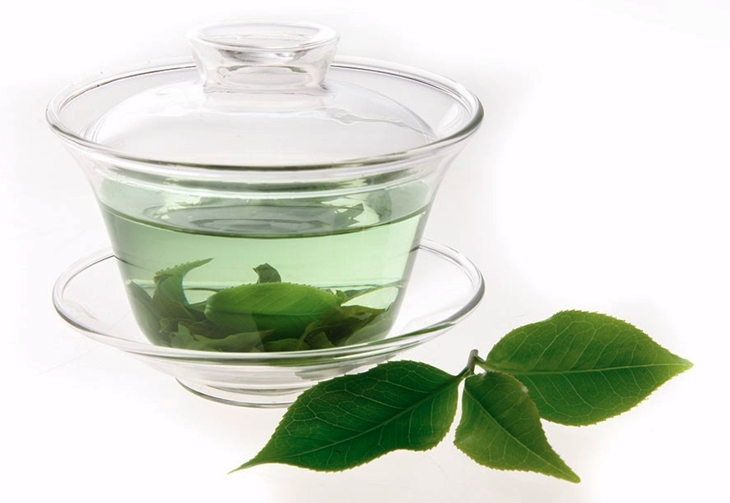
Value of Content Curation
A
B
C
Value No.2:
Curation brings clarity to chaos by making sense
of information.

Slide 20

Value of Content Curation
A
B
C
Value No.3:
Curation extends
the shelf life
of information.

Slide 21

Value of Content Curation
A
B
C
Value No.4:
For curators,
curation is an efficient way to build knowledge, skills, thought leadership
and network.
For organizations,
curation helps build staff expertise, improve banding and increase impact!
You are what you curate.

Slide 22
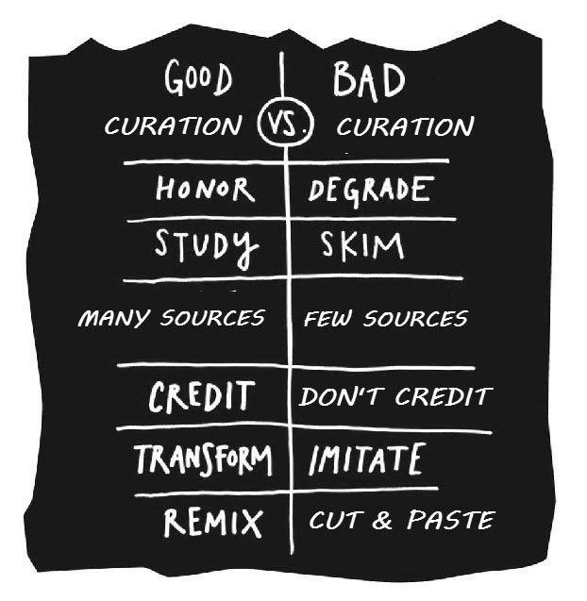
Be aware! There is good curation and bad curation!
Value of Content Curation
A
B
C
But………
Source: Beth Kanter, Good Curaion vs Bad Curation , http://www.bethkanter.org/good-curation-vs-bad-curation/
22

Slide 23

Value of Content Curation
A
B
C
“
The key element that makes curation work is the competence and focus of the curator and of the topic he has selected. Repeated efforts to create curated channels that mix and match broad and highly competitive topics are bound to see a very short life.
”
Robin Good
Master of Content Curation
23

Slide 24

Value of Content Curation
A
B
C
Are you
ready
to be a curator?
“
Those who can, curate.
Those who can’t, review.
Those who can’t review, tweet.
Those who can’t tweet, retweet.
”
via Beth Kanter
Author, Beth’s Blog, The Networked Nonprofit
Expert on nonprofits using technology for higher impact

